Slide 1
Teams in Transition
WiSD Hackathon
Emma Ritcey
Notes:
Hi everyone, I’m Emma and for my project I built an app that’s used to assess teams in transition.
Before I start I just want to thank all of the organizers of this event for putting this on, what you’ve done with it these last two years is amazing.

Slide 2
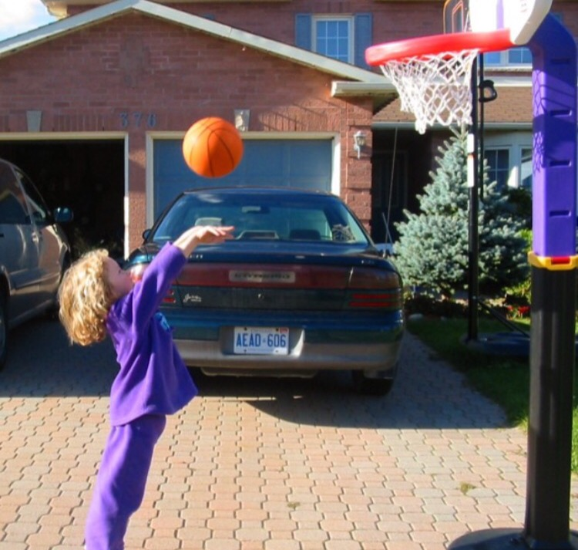
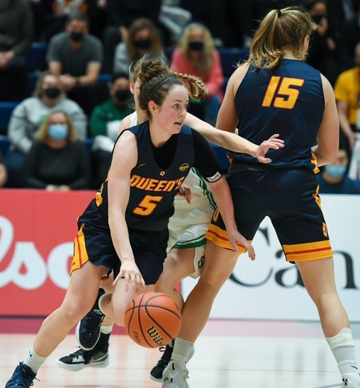
About Me
Grew up playing and watching sports
Computer Science at Queen’s University, BSc. & MSc.
Varsity basketball player
Notes:
So a little bit about me, I grew watching and playing a bunch of sports
And I ended up playing 5 years of varsity basketball while at university, so I was really excited when I found out that this year’s data would be basketball data
And this year I finished my masters in computer science at Queen’s

Slide 3
Motivation
Soccer
Basketball
Transition
Line breaking passes
Players that put pressure on defense using the pass
How do different teams and players attack in transition?
Can teams improve their offensive output by taking advantage of transition opportunities?
Notes:
So the initial motivation came from soccer and the idea of line breaking breaking passes.
And I wondered if that could be a useful thing to measure in basketball in the sense of what players or teams are putting the most pressure on the defense or gaining advantages by breaking through lines of defense.
So then that made me focus specifically on transition as this is the part of the game where there’s the most space and opportunity to pass the defense.

Slide 4
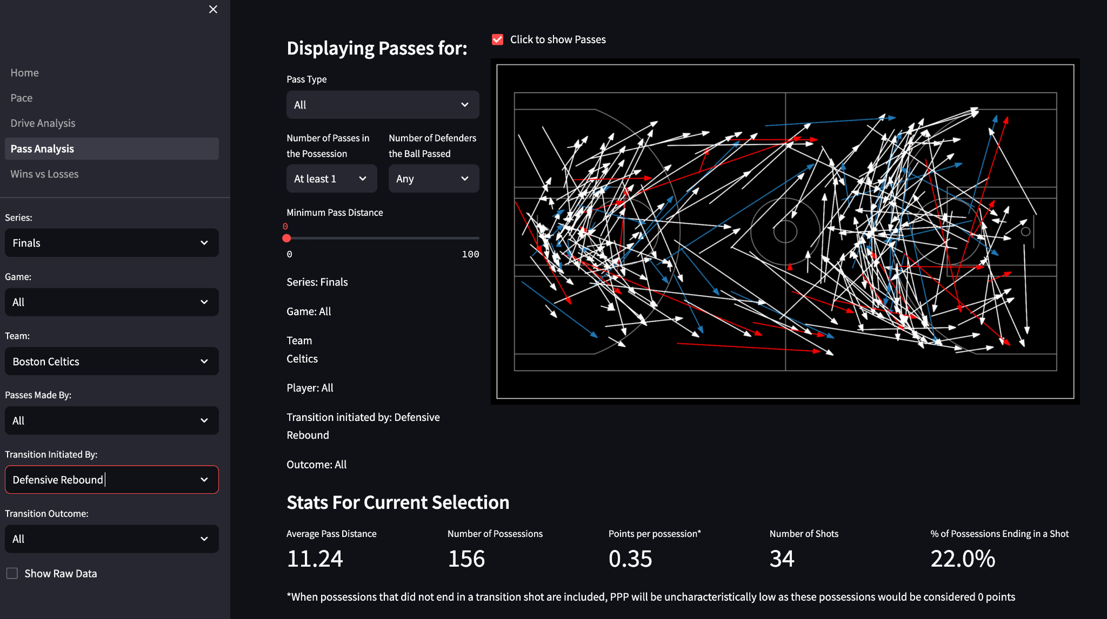
Final Product
Dashboard aimed to assess teams and players transition tendencies
Implemented using Streamlit
Notes:
So from there I built a dashboard that visualizes passes and drives and uses specific metrics to assess teams and players.

Slide 5
Data Collection
Download tracking data and event data from AWS S3 bucket
Merge event data with play-by-by data from nba–api
Extract every potential transition opportunity
First 8 seconds of possessions beginning from a forced turnover, defensive rebound, or made field goal
Extract all drives
Any time a player took at least 1 dribble
Extract all passes
end of pass determined by the first ‘TOUCH’ event after the pass
Notes:
Very briefly I’ll go over the data collection and preprocessing
First I downloaded the tracking data and event data
And I merged the event data with play-by-play data
I then extracted every potential transition opportunity from all of the games.
I defined a transition opportunities as the first 8 seconds of a possession that began from a non-dead ball ((after turning the offensive team over, grabbing a defensive rebound, or directly after being scored on (not including made free throws)))
I then extracted all drives that occurred during the transition opportunities. For simplicity I defined a drive as any time a player took at least one dribble.
Then I extracted all passes that occurred during the transition opportunities. ((The end of the pass was determined by the first ‘TOUCH’ event after the pass, which isn’t always completely accurate if the ball was tipped, but again this was for simplicity.))

Slide 6
Data Collection
Summarize each transition opportunity possession
# of passes
# of drives
trigger: defensive rebound, turnover, made shot
outcome: shot, no shot, non-shooting foul, turnover, stoppage
Summarize each drive and pass
start location
end location
driver/passer
# of defenders passed
pass/drive type
paint touch (based on end location, for drives only)
Notes:
I then summarized each transition opportunity by the # of passes, # of drives, how the possession started, and the outcome
And I summarized each drive and pass by the start and end locations, the player who made the pass or drive, the type of pass or drive, and then specifically for drives, whether the drive ended within the paint
Note
stoppage → game stops for any reason including ball goes out of bounds, kick ball, inadvertent whistle

Slide 7
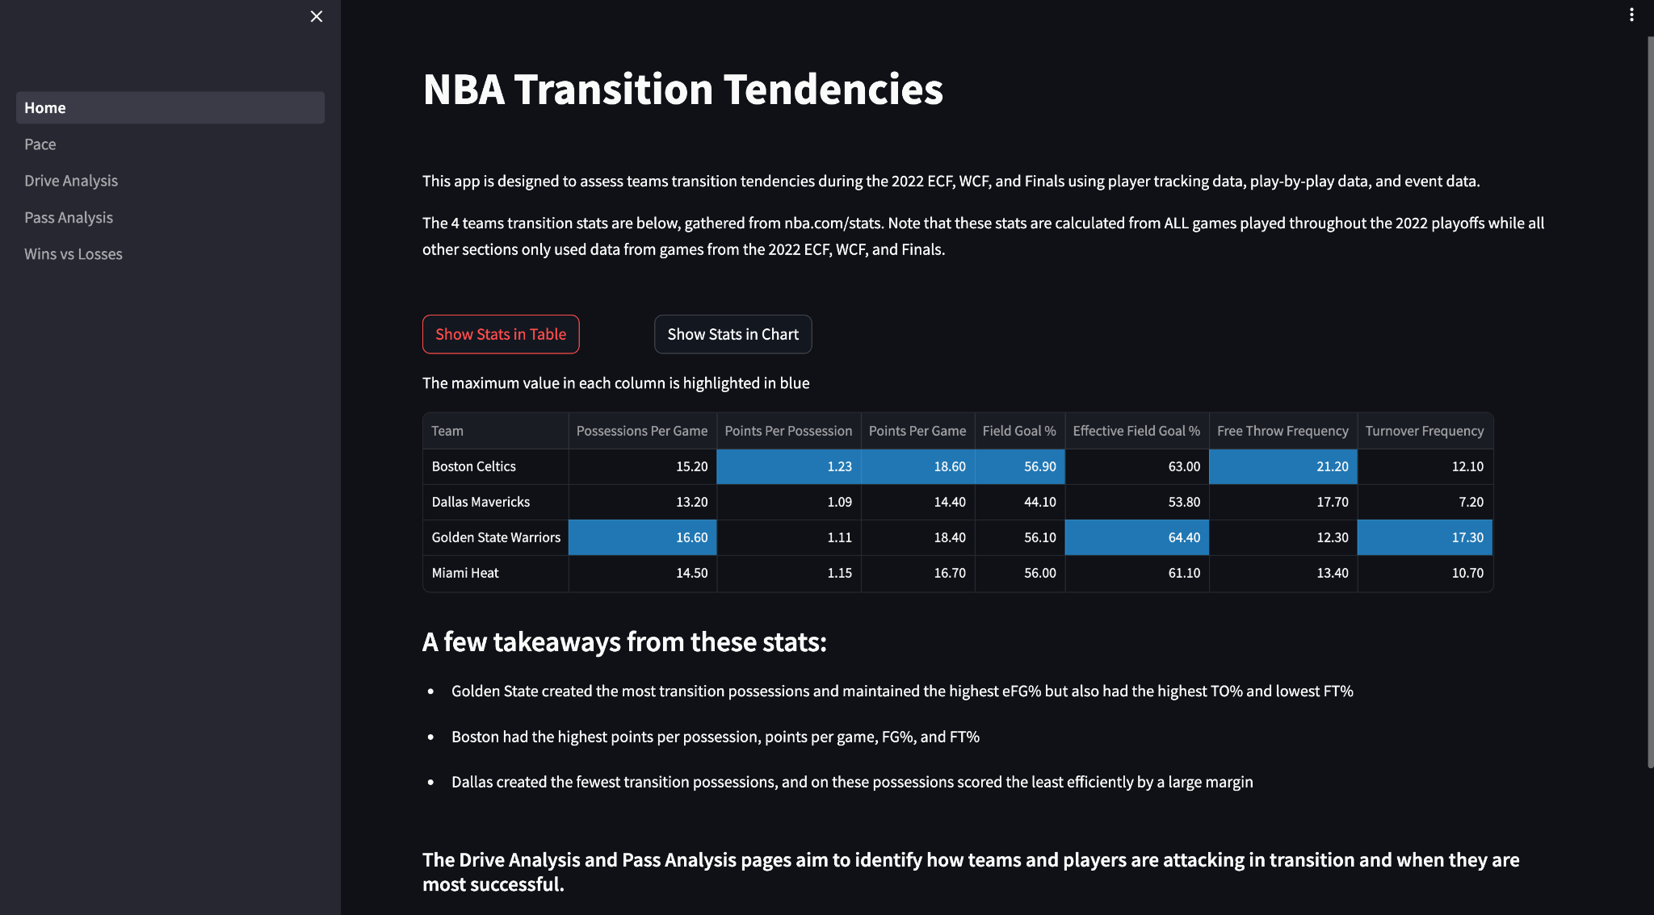
Data Collection
2022 Playoff Transition Statistics
Notes:
I also collected transition stats from nba.com and put those on the home page of the app to be able to give a base reference for how each team played in transition
This Shows that overall Boston was the best team in transition
And Dallas played the slowest and scored much less efficiently

Slide 8
Data Analysis: Clustering
Notes:
Moving onto the data analysis, I clustered the passes and drives into groups to be able to look at specific types separately

Slide 9
Clustering
Passing
Driving
Defined 10 different types of passes
k-means clustering with k = 10
features: start location, end location
Defined 8 different types of drives
k-means clustering with k = 8
features: start location, end location
Notes:
Using just the start and end locations, I used k-means clustering to identify 10 different types of passes and 8 different types of drives.
I chose the number of clusters just by visually assessing the clusters while keeping in mind what they mean within the context of the game.

Slide 10
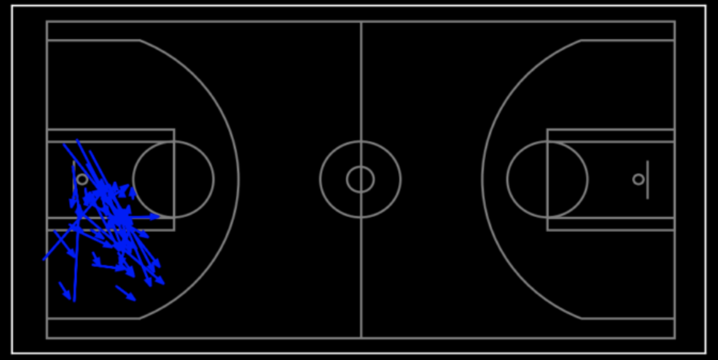
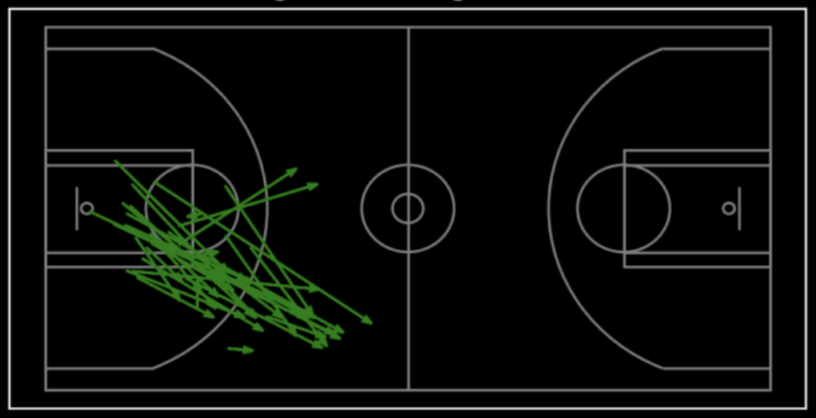
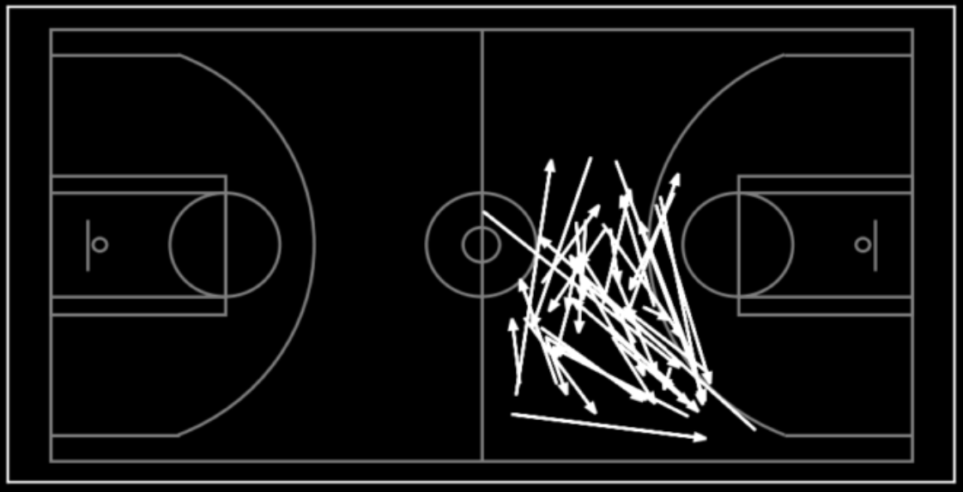
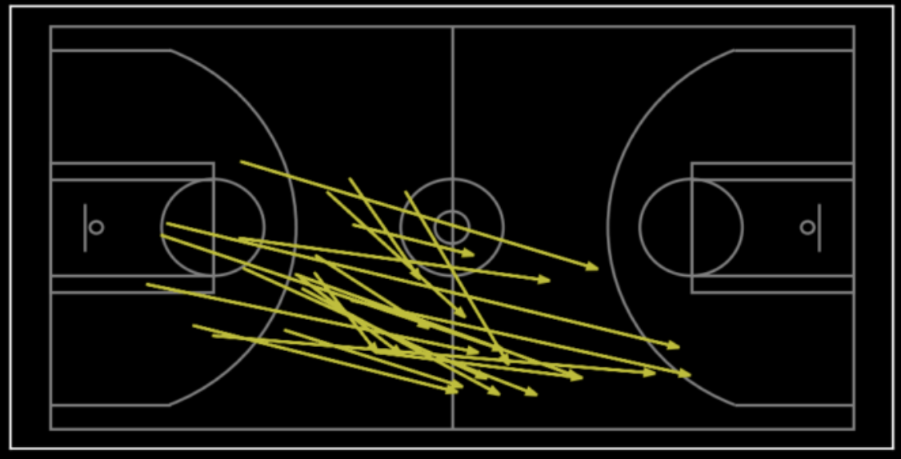
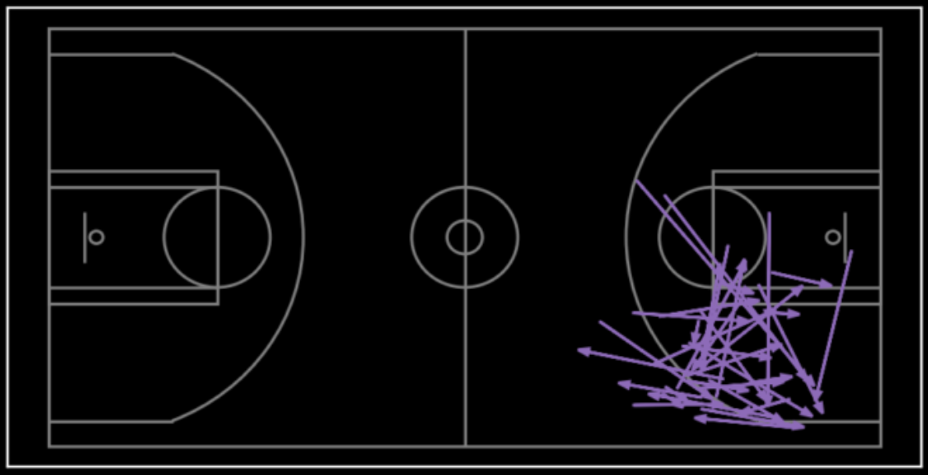
Types of Passes
Short Outlets
Long Outlets
Swing Passes
Hit Aheads
Attacking Passes
Notes:
I then assigned each cluster a name
We have short outlets, long outlets, hit aheads, and then passing within the three point line which I called Attacking passes, and then finally swing passes. And then each of these are repeated on the left side of the floor to make up the ten groups.
It’s definitely not perfect, but overall does a pretty good job

Slide 11
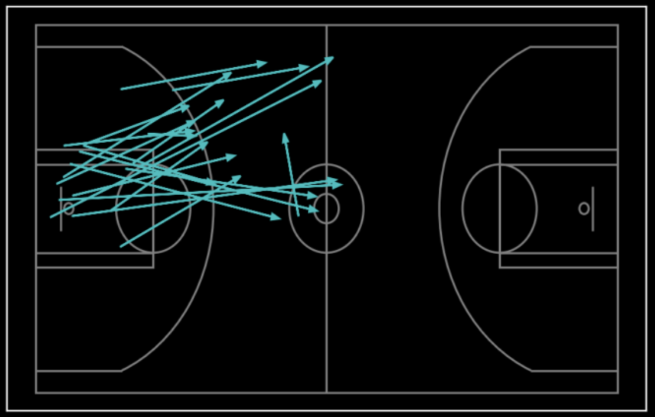
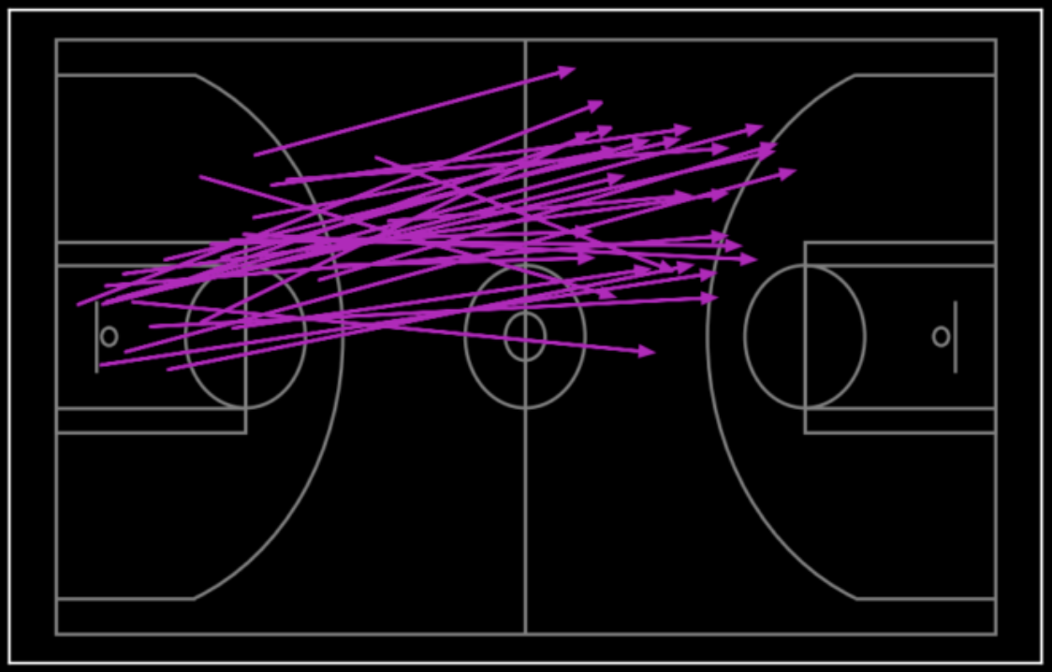
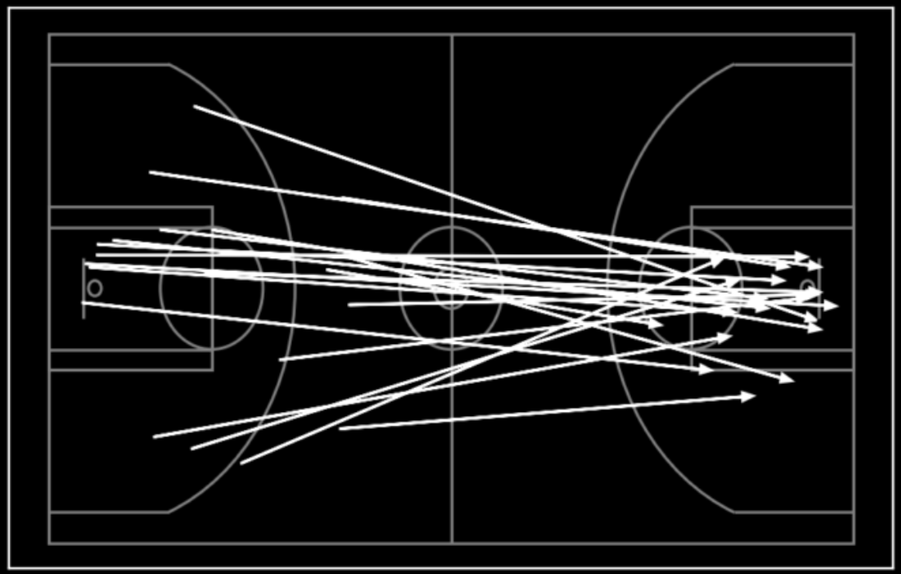
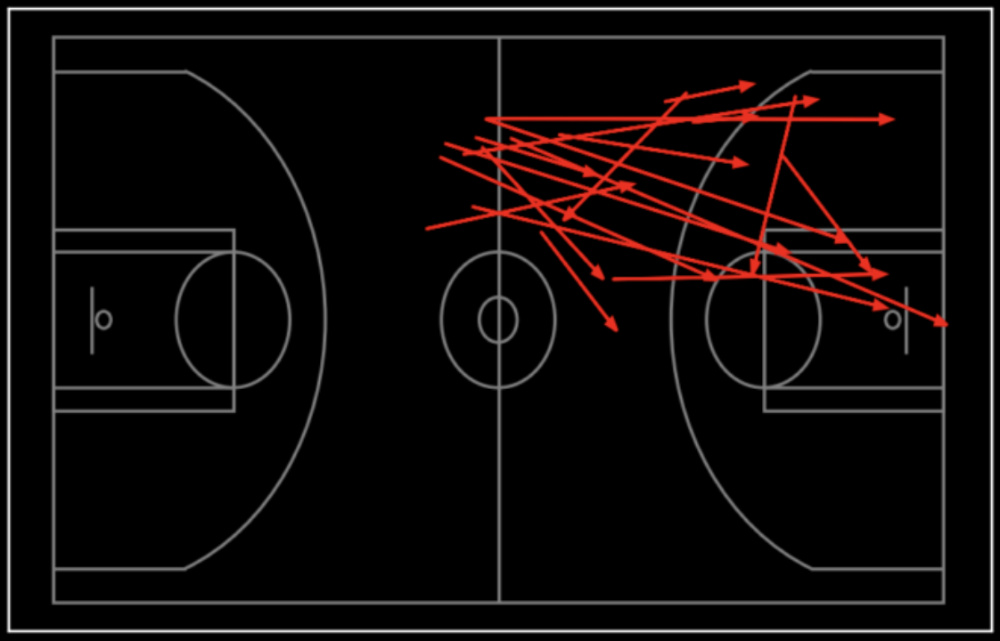
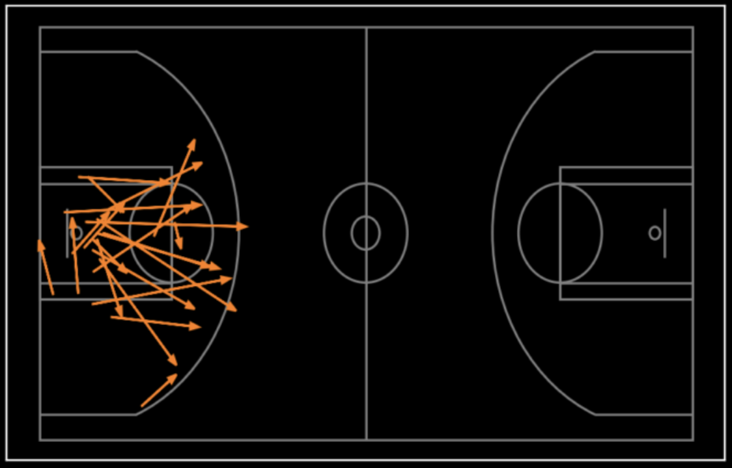
Types of Drives
Back Court, left
¾ court, left
Full Court
Front Court, left
Backcourt, short
Notes:
Then for drives we have backcourt drives on the left side of the court, ¾ court drives on the left side of the court, and front court drives on the left side. Each of these three types of drives are also repeated on the right side of the floor to give us 6 types of drive. And then we have short backcourt drives and then finally full court drives.
The thing to remember with the drives is that these clusters are only based on their start and end locations, So the drives could actually be very different with respect to their complete paths. But for simplicity, this is how I grouped the drives.

Slide 12
Data Analysis:
Pass Locations
Notes:
Now I’ll go through some examples of how the dashboard can be used and insights that can be drawn. I’ll be going through a lot of charts pretty quickly but I wanted to give the broadest possible view into what you can do with it.
So one of the parts of the dashboard is looking at drive or pass locations. I’m going to show an example of how you can get a sense of a teams style of play based on their passing

Slide 13
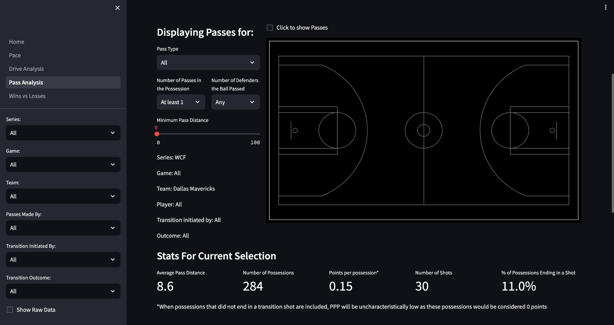
Notes:
So this is what the dashboard looks like
On the left are a bunch of filters you can select to narrow down the passes you want to look at
As an example, I’ll show all of Dallas’s passes the Western Conference finals

Slide 14
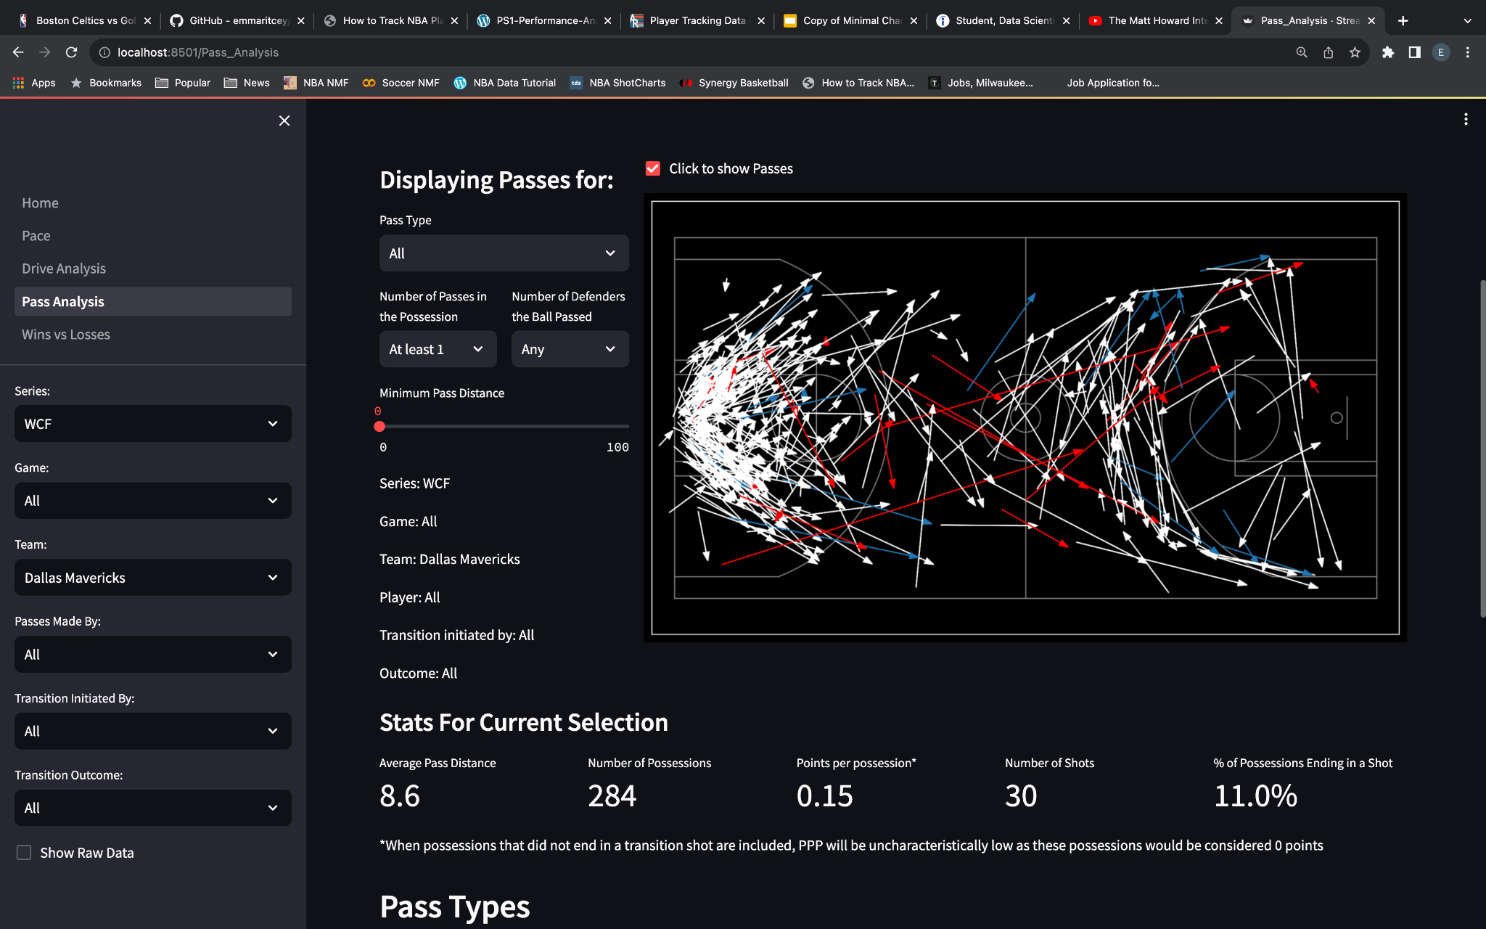
Notes:
The white arrows represent passes during a possession where no shot was taken within the first 8 seconds
The red represents passes where the team scored
And blue represents passes where the team missed a shot
You can also drill down to see passes made by a specific player or just off a defensive rebound or turnover.
For today, I’m just going to show how Dallas’s passing compares to Golden States

Slide 15
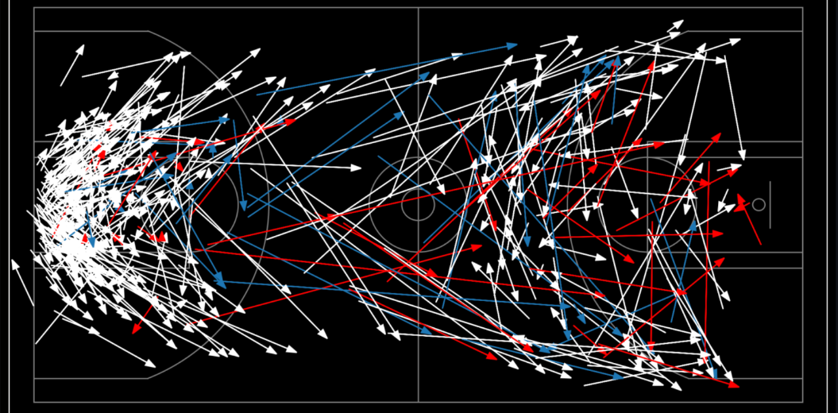
Dallas
Golden State
Notes:
So this is the same visualization from the last slide
And now comparing that to Golden State’s passes from the same games, you can see how differently these teams move the ball
Looking at the middle third of the court, Golden state has a lot more hit ahead passes where they’re pushing the ball up the court.
And looking at the front court, Golden State also has significantly more passes inside the three point line. So once they’re getting to the front court, they’re attacking and kicking the ball out and then making an extra pass. This is already a known fact about how they play, but when you’re considering how hard it is to guard golden state over the course of a game, each one of these passes is another closeout and another rotation that the defense has to make just in the first 8 seconds. Whereas with Dallas, they’re not making the defense work as hard.
I think this comparison shows the contrast in the two team’s styles and can give you some potential insight as to why Dallas has poor transition numbers.

Slide 16
Data Analysis:
Pass and Drive Production
Notes:
So another way this app can be used is by comparing metrics to see how teams attack and produce their points

Slide 17
Production
Passing
Driving
team and individual level
defenders passed
points per possession
team and individual level
defenders passed
points per possession
speed
paint touch
Notes:
For assessing passing, you can look at the number of defenders passed and the points per possession
For assessing drives, you can look at those along with the speed and whether there was a paint touch
All of these can be broken down by team or by player
PPP = (2*2FG + 3*3FG + 1.5*SF) / # of possessions

Slide 18
Data Analysis:
Team Pass Production
Notes:
I’ll first start off with how teams attack using the pass

Slide 19
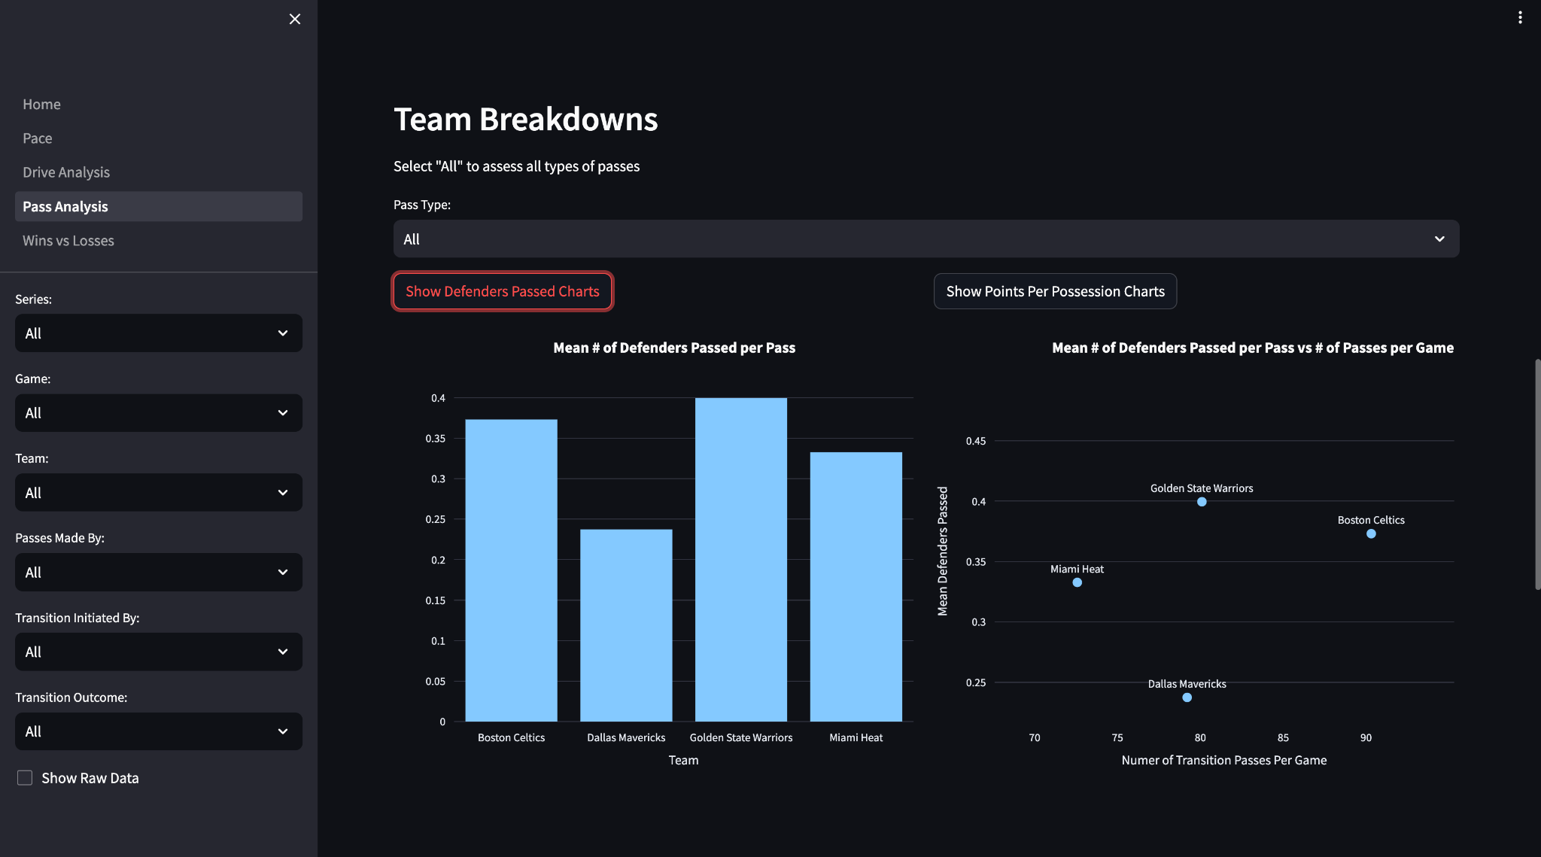
Notes:
Starting off with the idea of line breaking passes, you can compare the mean number of defenders passed per pass for each team.
So taking all passes into consideration, we can see in the left chart that Golden State on average gains the most advantage on their passes and in the right chart that Boston makes the most number of transition passes.
The main type of pass where you’re really looking to pass the defense is with hit ahead passes,

Slide 20
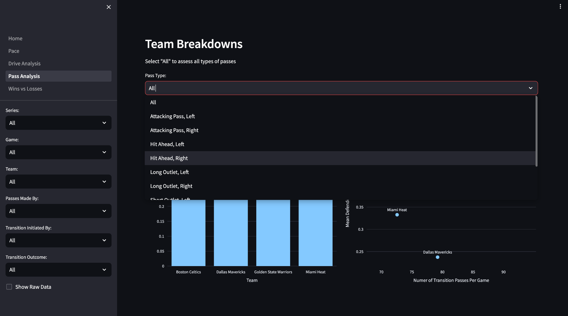
Notes:
so we can look specifically at hit ahead passes, first on the right side of the court,

Slide 21
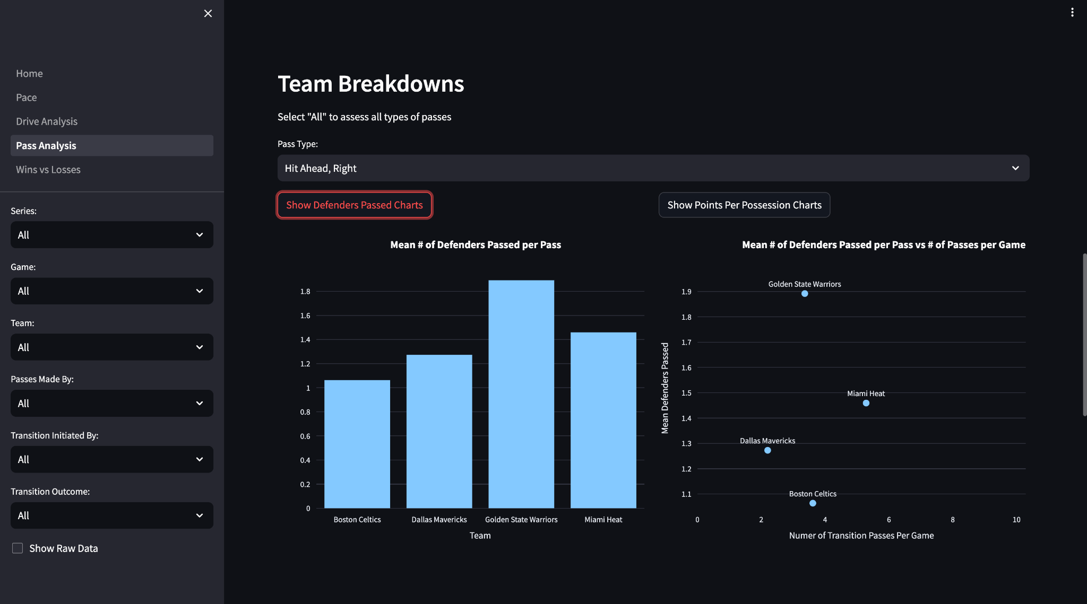
Notes:
Golden state is by far the best at gaining an advantage, passing almost 2 defenders on each pass

Slide 22
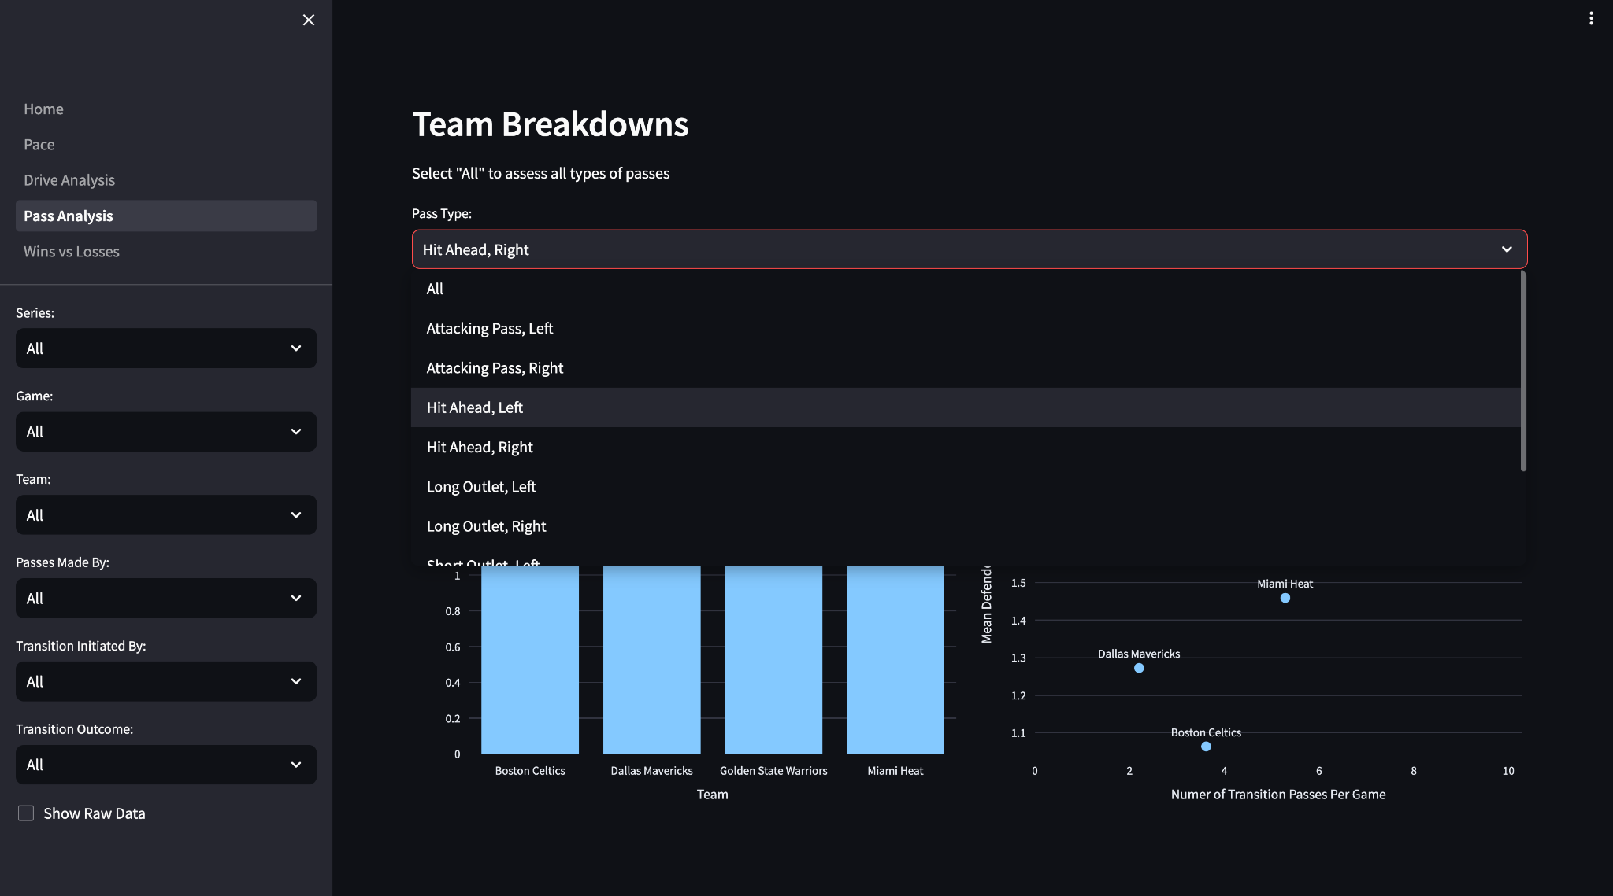
Notes:
Looking now at hit aheads on the left side of the court

Slide 23
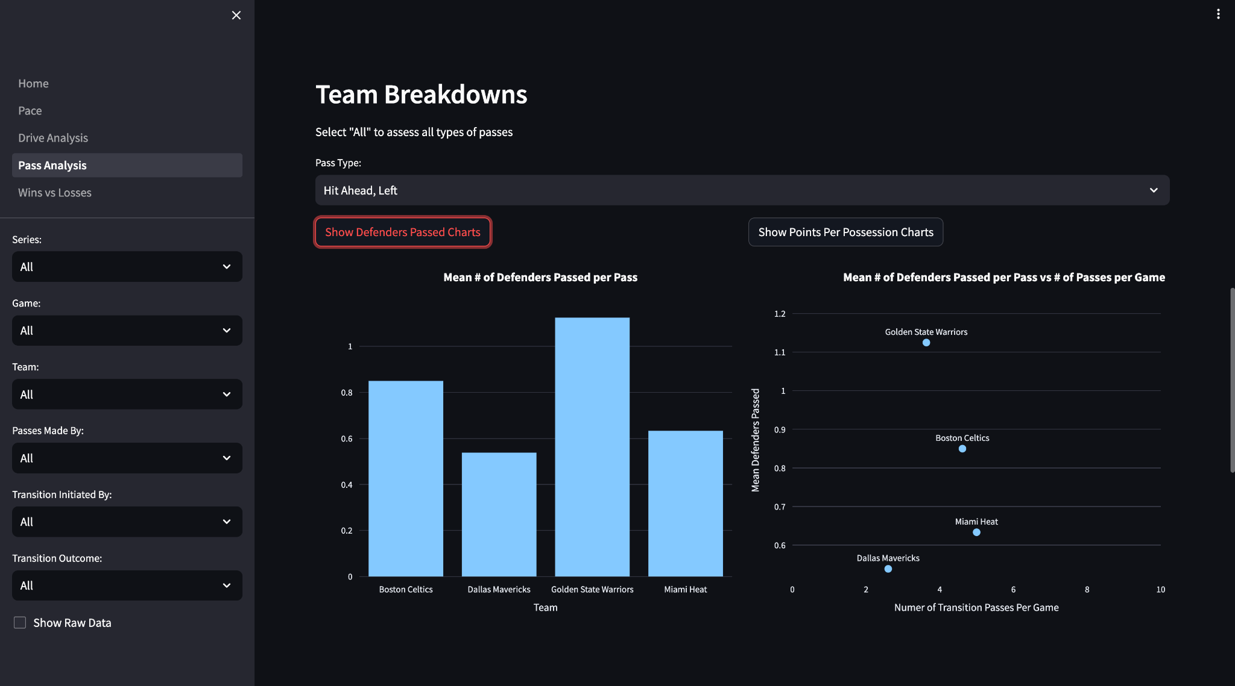
Notes:
we can see that golden state still leads, but they typically gain less of an advantage with passes on the left side of the court, passing just over 1 defender on average.
Overall, Dallas completes the fewest hit ahead passes. This was observed when we saw their pass locations, and is definitely one way that Dallas lacks pace in their play,

Slide 24
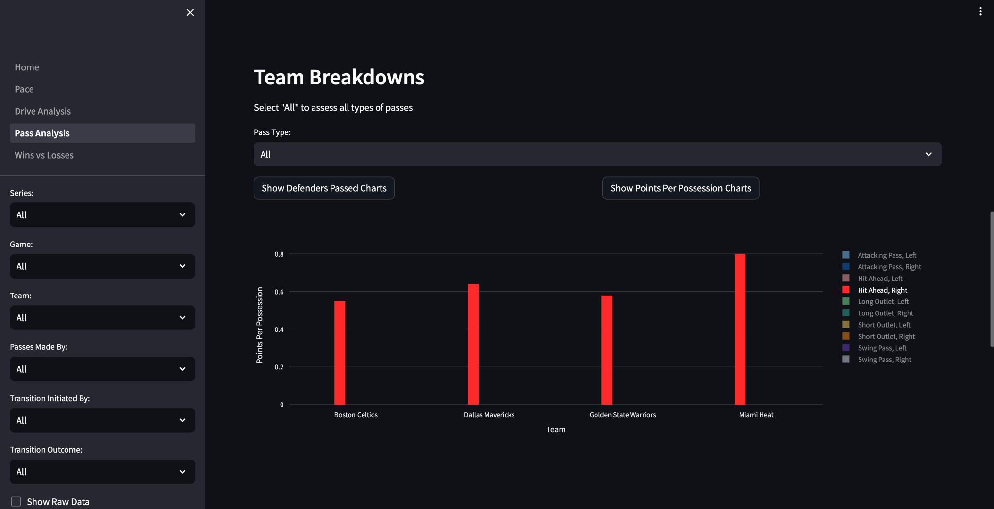
Notes:
You can also assess how much a team is scoring off of different types of passes by comparing their points per possession
Looking specifically at hit aheads on the right side of the court, miami actually scores at the highest rate
So Golden State passes the most defenders, but Miami actually looks to score more off of hit aheads, at least in the first 8 seconds.
You’ll notice that the points per possession here is lower than normal because I included possessions where no shot was taken in the calculation. For all of those possessions, the points scored is zero which skews it to be low. If you select ‘shot’ under Transition Outcome on the sidebar then this gives a non-skewed measure since it discounts possessions where no shots were taken.
At times like in this example I like looking including all possessions because it gives a sense of how efficiently a team is scoring and also how often a team is looking to score. For example, if a team isn’t taking as many shots within the first 8 seconds as another team, unless they’re scoring much more efficiently when they do shoot, then their PPP will be lower.

Slide 25
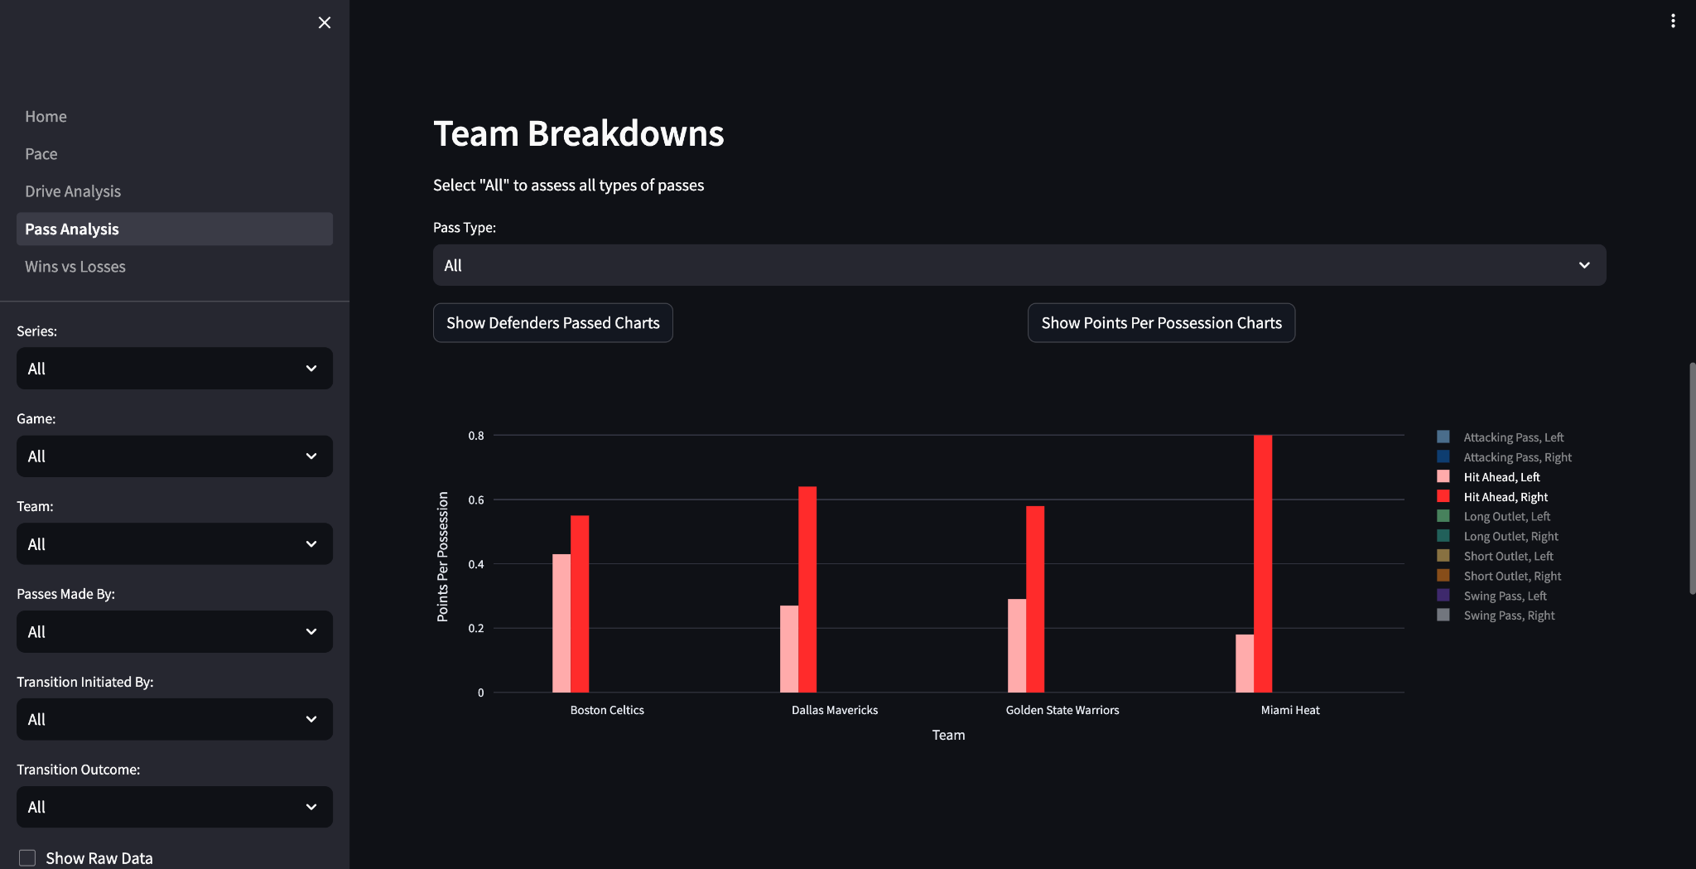
Notes:
Then comparing with left hit aheads, every team’s points per possession drops off, especially Miami’s. So if I was an opponent of Miami’s I would be really conscious of the fact that they’re looking to attack much more when they’re pushing the ball up the right side of the court than the left.
You can also dive into passing at the individual level but for the sake of time I’m going to move onto examples of assessing Drives

Slide 26
Data Analysis:
Team Drive Production
Notes:
First starting at the Team level, an important part of creating off the dribble is not only passing the defense but getting to the paint,

Slide 27
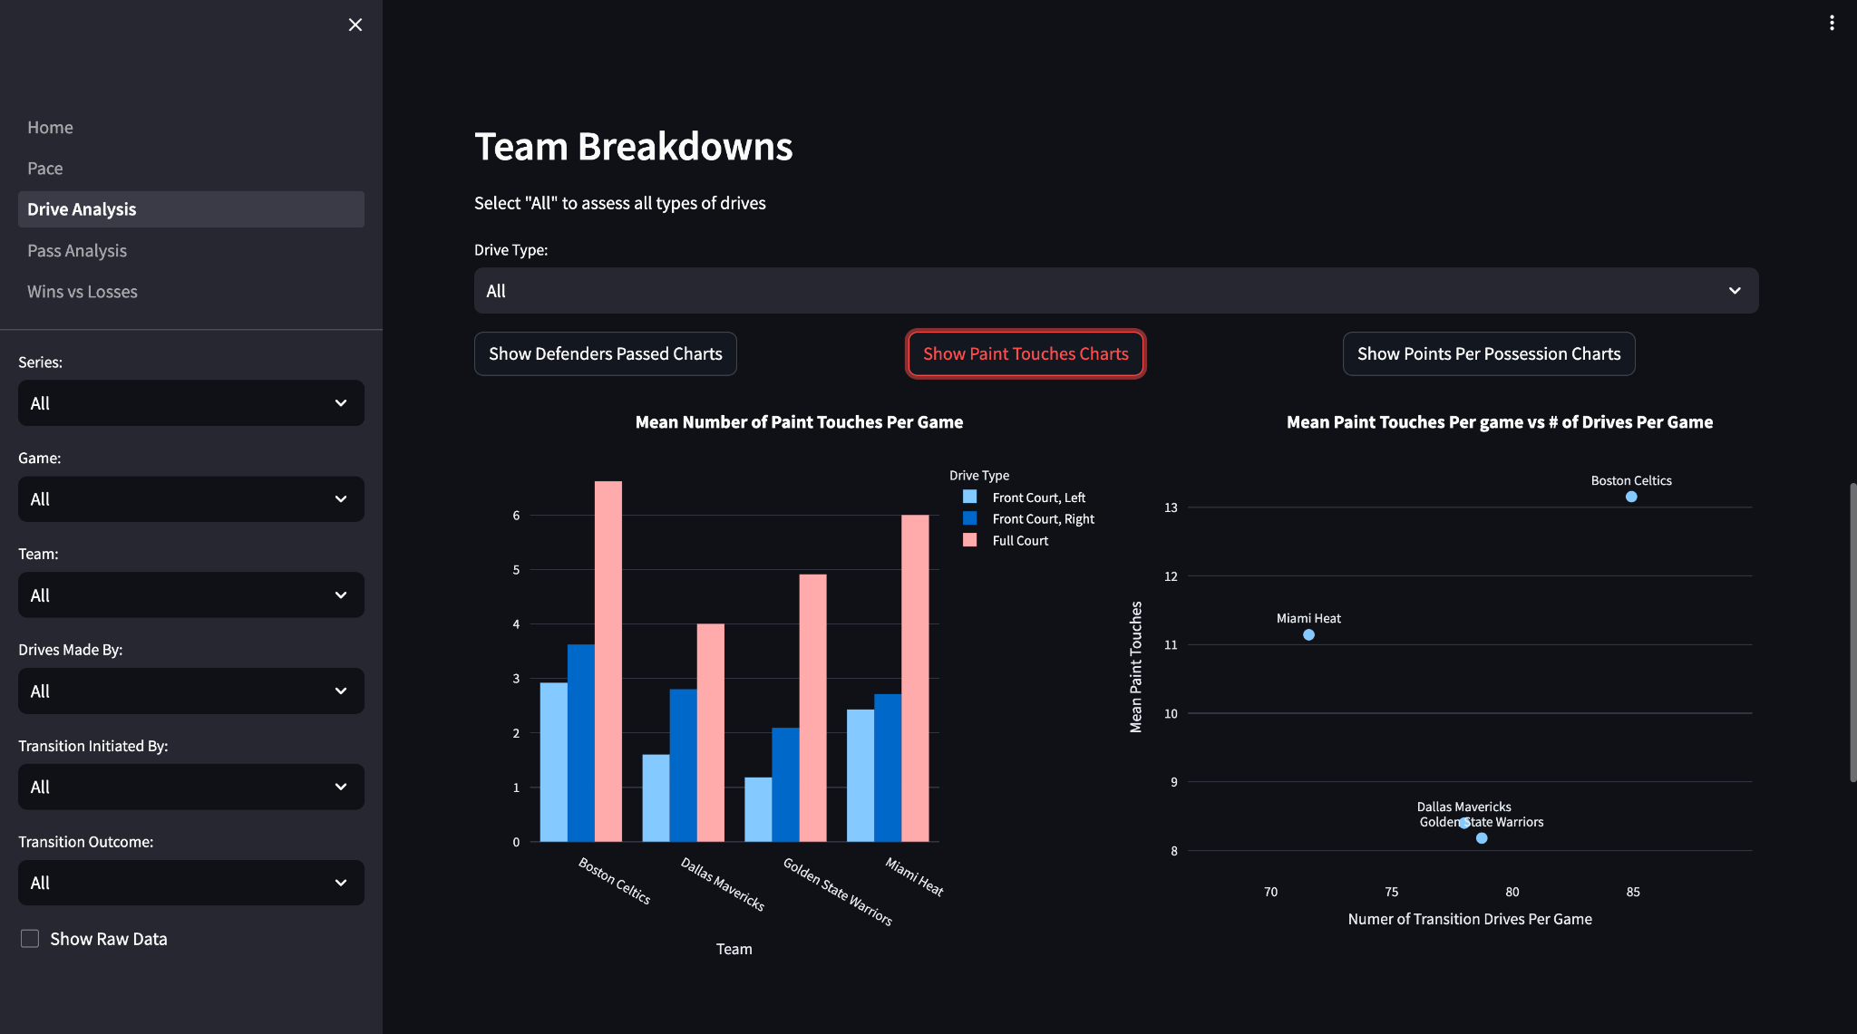
Notes:
So this chart on the left compares the number paint touches per game for each team
Only 3 types of the drives I mentioned earlier have the possibility of ending in a paint touch so this chart here is broken down into those drives - so Front court drives on the left and right, and full court drives
We can see that boston gets to the paint the most often on all three types of drives and each team gets to the paint more often on the right side of the court compared to the left
Another way you can compare teams is by Points per possession

Slide 28
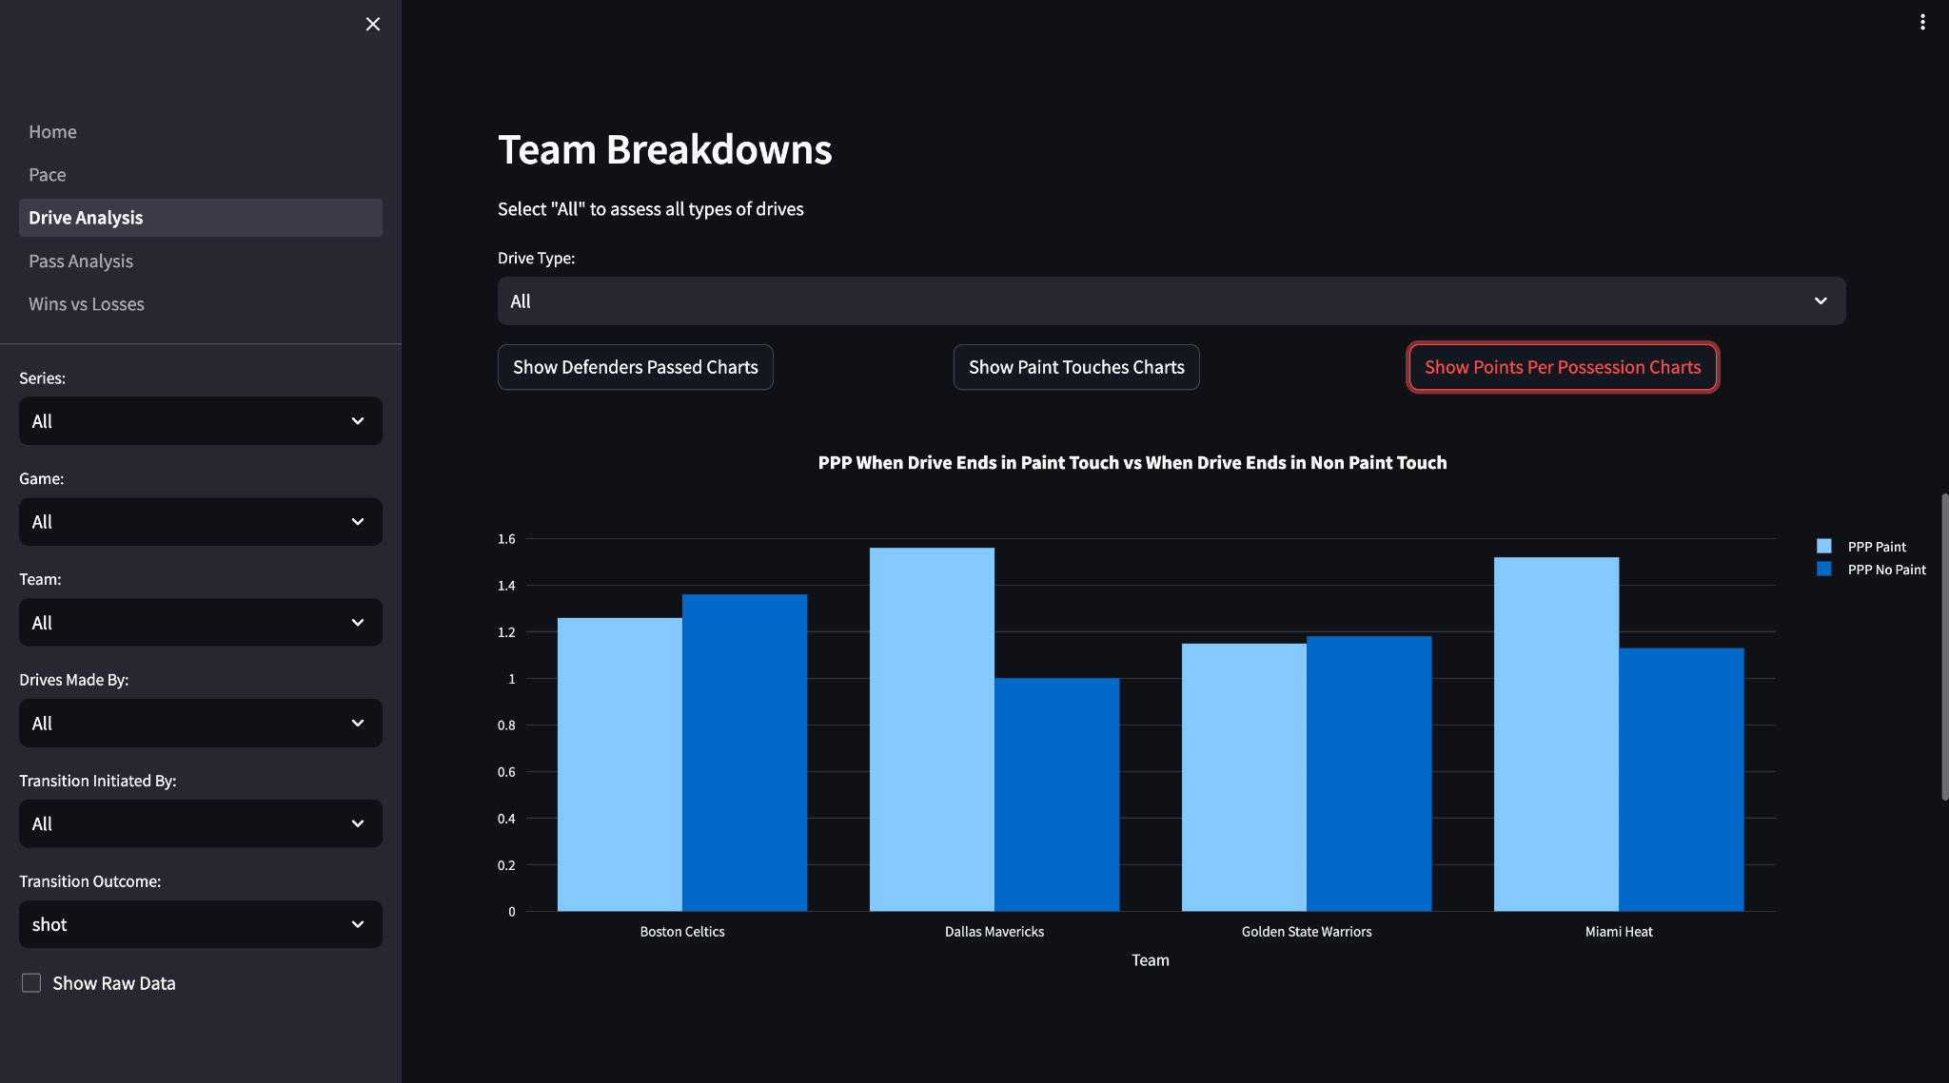
Notes:
I’ve broken this metric down into two categories, when the drive ends in a paint touch and when it doesn’t end in a paint touch.
I’ve filtered this to only include possessions where a shot was taken since the majority of the time when a team isn’t taking a transition shot they’re not trying to get into the paint.
We can see that Miami and Dallas score more when they’re able to get into the paint, where as Boston and Golden state score about the same amount whether they get into the paint or not, which really points to the types of players they have.
Specifically for Dallas, who had the lowest effective field goal % in transition by far, emphasizing getting to the paint more often to create better shots could help increase their transition field goal %.
Then we can look just at one specific type of drive
Note:
When we were looking at the teams paint touches, Dallas got to the paint the least, but they score significantly more when they get to the paint. Knowing that they play at the slowest pace and get to the paint the least, if I were to see this as a coaching staff I would really encourage creating more by getting to the paint early in the shot clock before the defense is set because it clearly pays off for them. It’s possible that they score so well because they’re mainly only attacking when they have a clear lane or advantage and this number could drop off for them if they start attacking more, but with players like Luka and Brunson I think it would benefit them

Slide 29
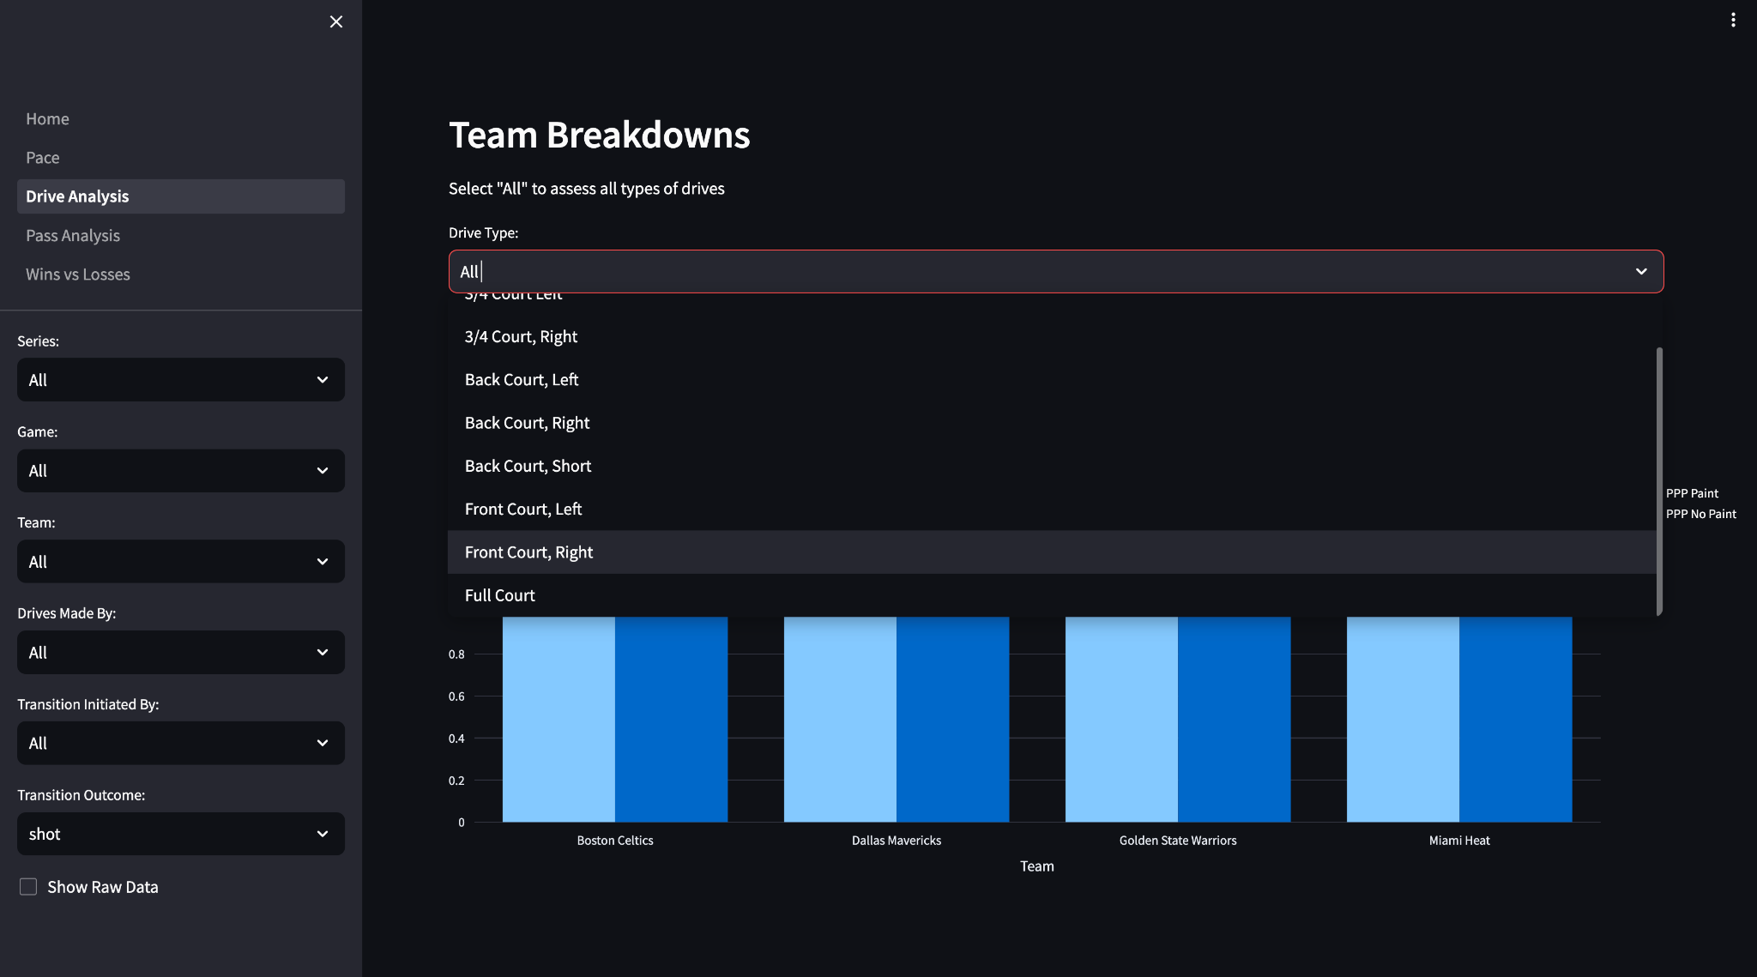
Notes:
for example, drives in the front court on the right hand side

Slide 30
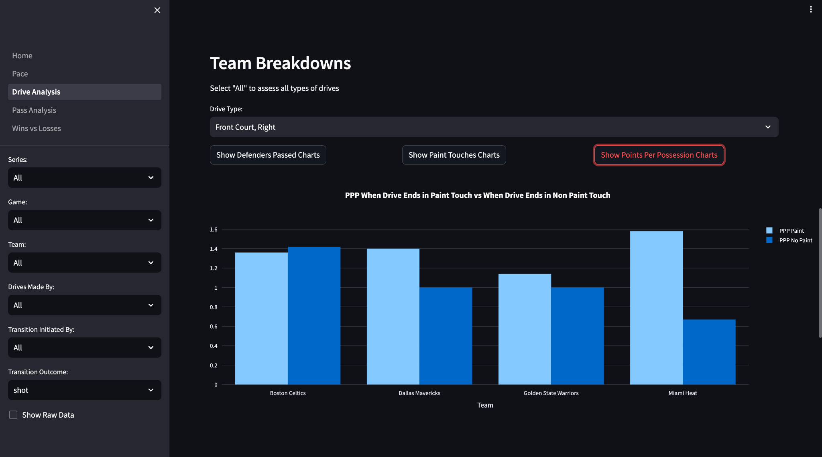
Notes:
There is a huge difference in Miami’s scoring when they get into the paint. So for opponents of Miami, keeping them out of the paint is very important to reduce their scoring.

Slide 31
Data Analysis:
Individual Drive Production
Notes:
So then we can dive into the individual players

Slide 32
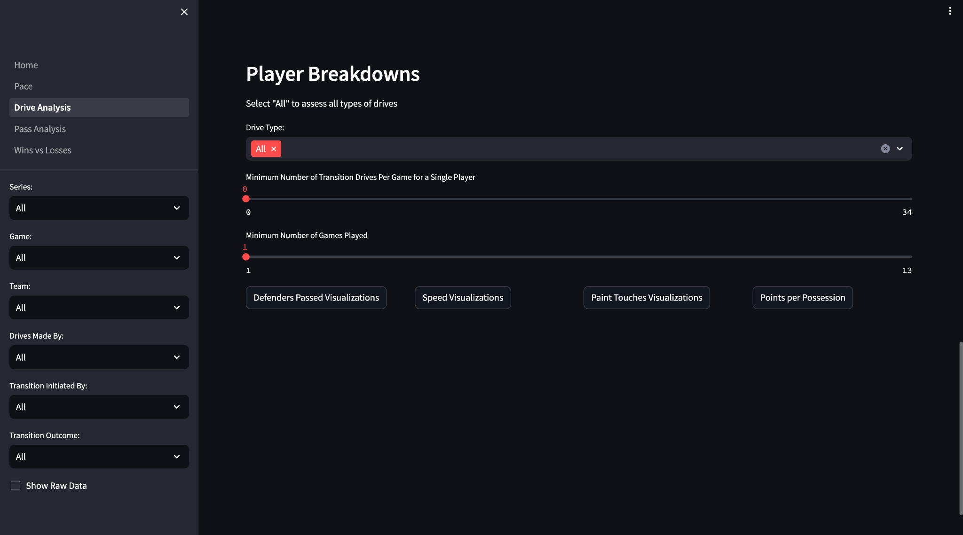
Notes:
You can filter by the number of passes they make per game and the number of games they played to filter out some players who don’t play a lot

Slide 33
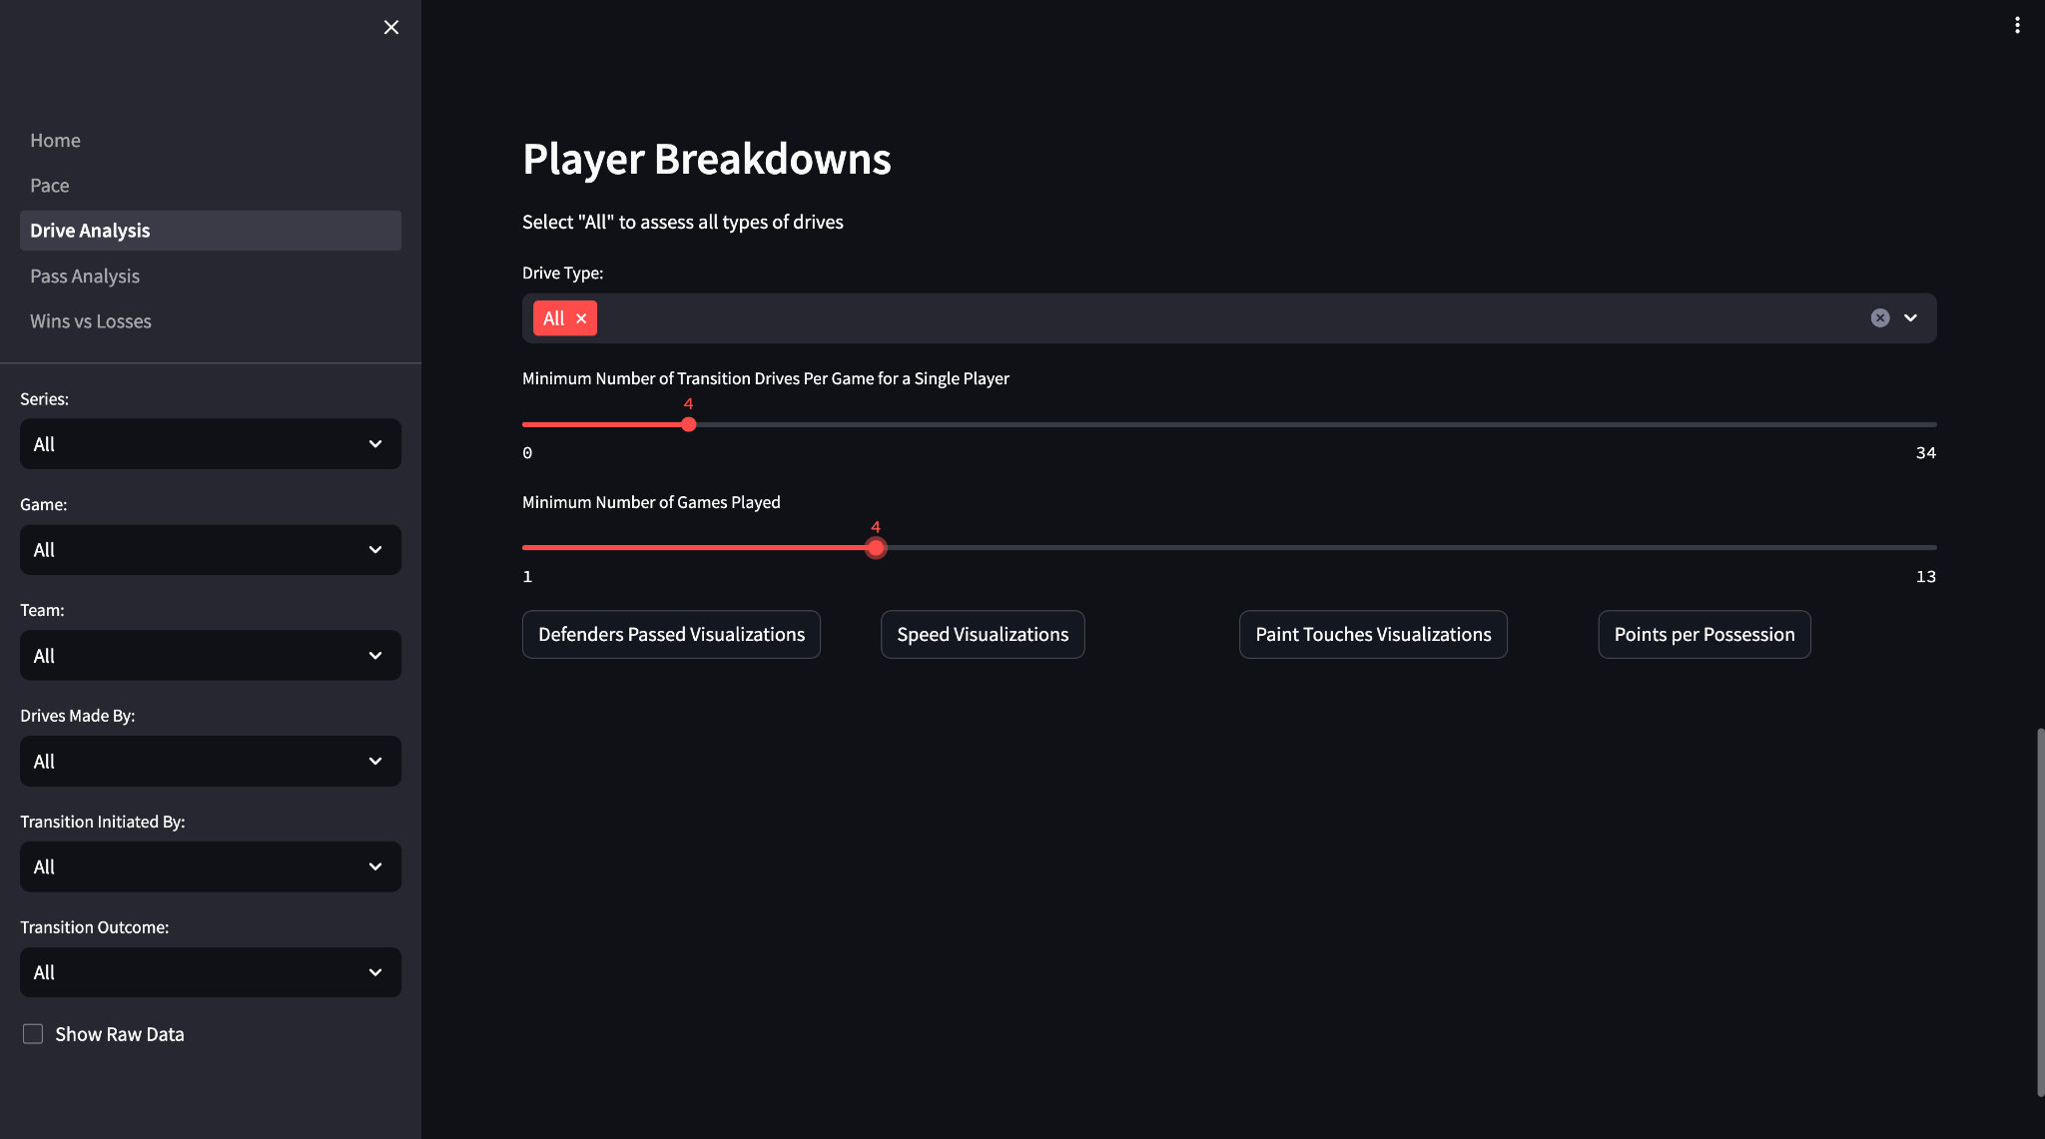
Notes:
So I like to initially set both of these to four
And then looking first at who’s passing the most defenders on the drive,

Slide 34
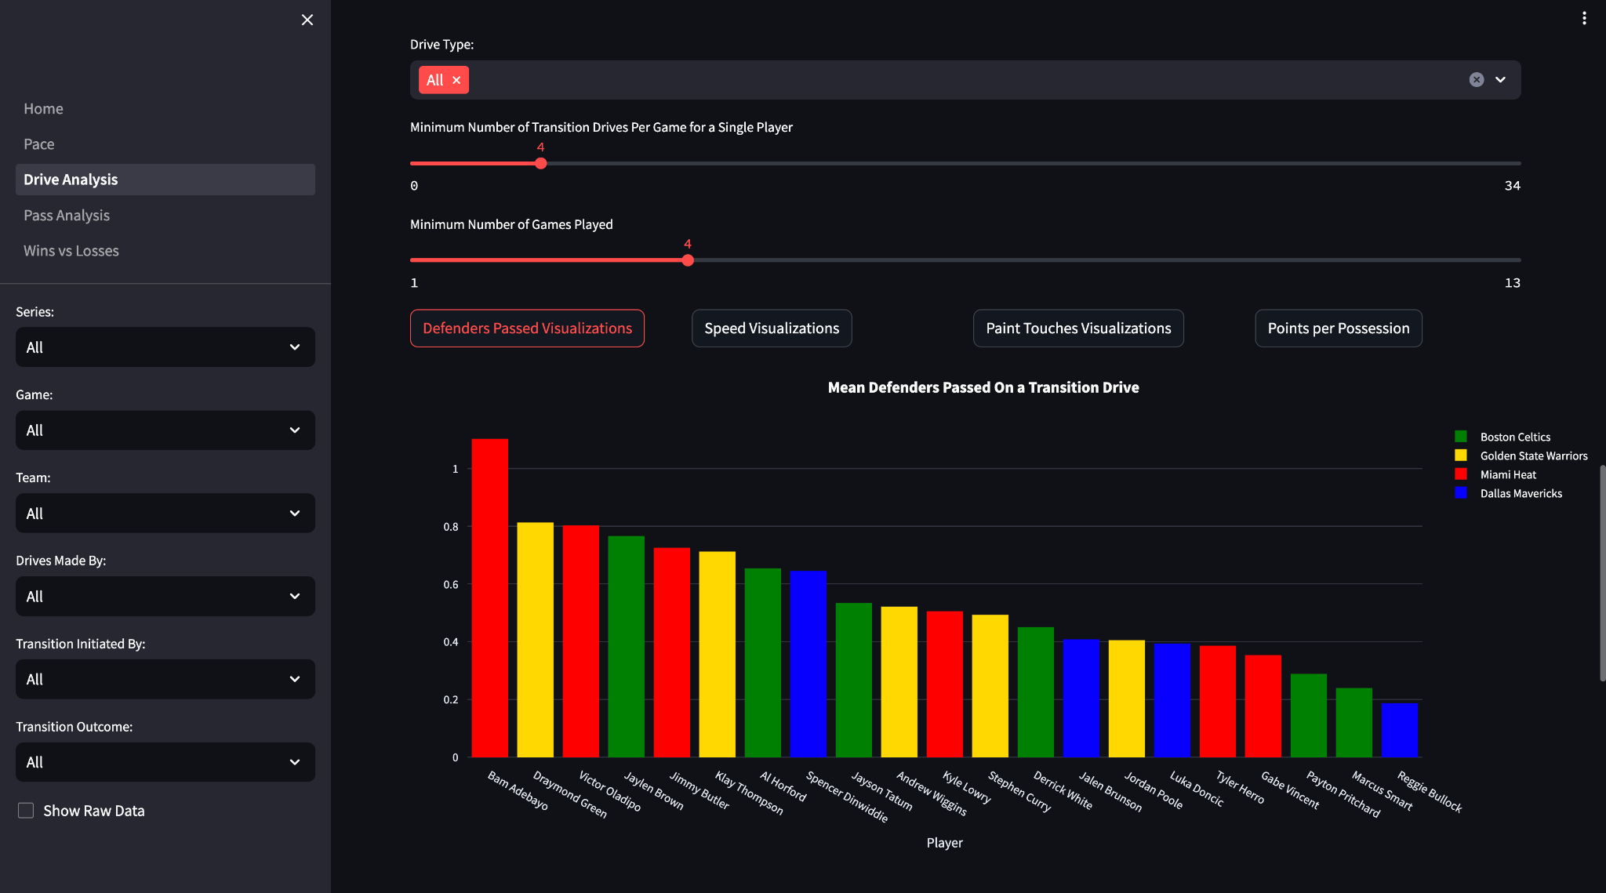
Notes:
It’s actually Bam Adebayo, which is interesting because he’s a post player. But if you’ve watched him play you know that when he gets a rebound he’ll often start the break himself and passes at least that first line of defense so this makes sense.
And if we’re comparing all the center positions here, we have Bam, Al Horford, and Draymond Green, but Dallas doesn’t have any of their big men on this list, which means they don’t have a big man who is getting rebounds and consistently starting their break, so they’re often slowing their offense down right from their defensive rebound. So if Dallas was looking to pick up their pace of play, i think this points to one way that they could do that
Now we can look at which of these players get to the paint the most often

Slide 35
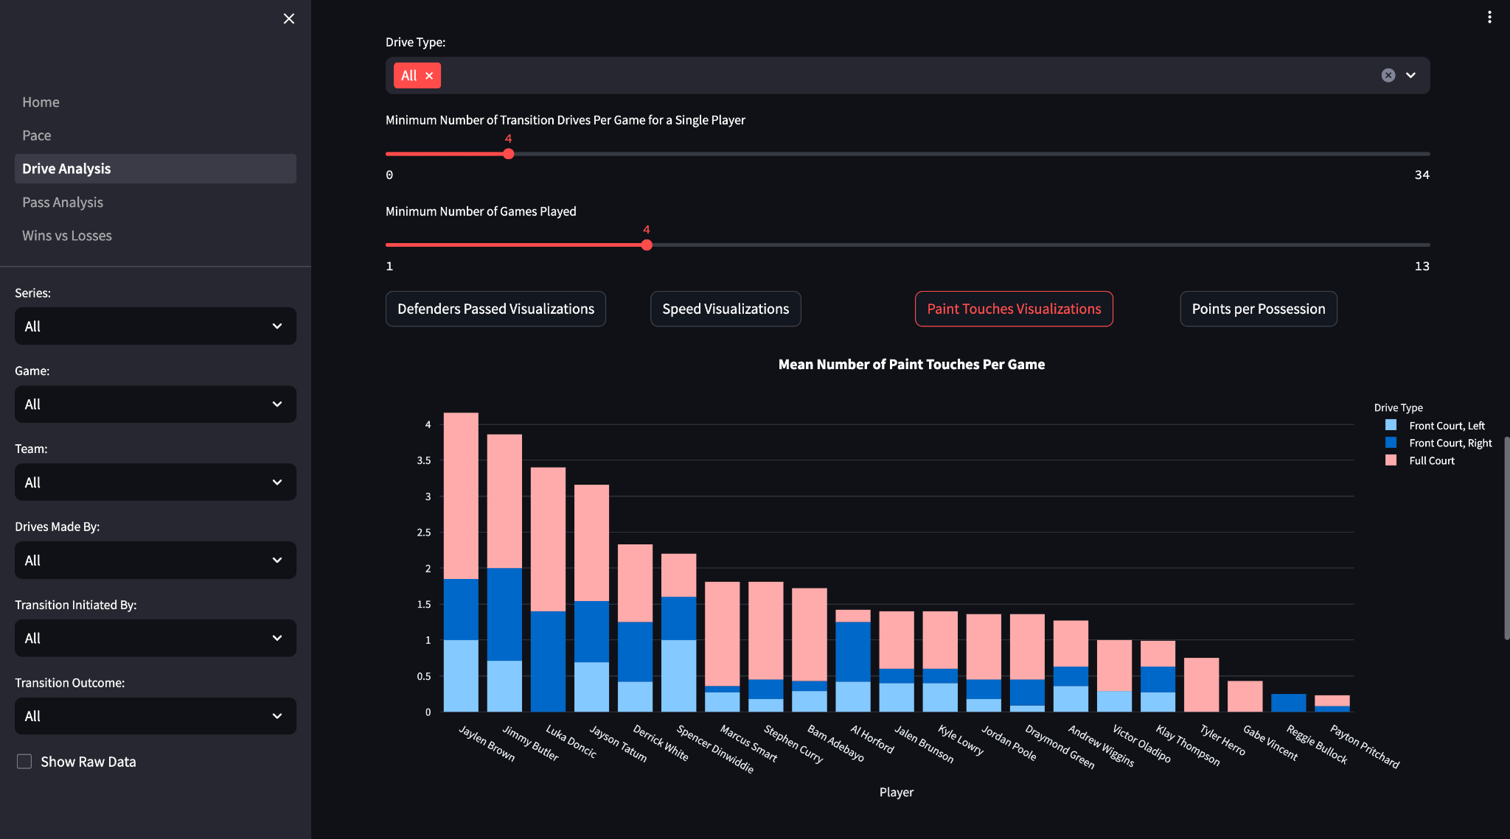
Notes:
I previously showed that Boston gets into the paint the most often, and this chart shows that three out of the top five players here are on Boston, which really emphasizes why they score so well in transition and how many threats they have off the dribble
You can also use this to assess your teams transition defense by looking at how often you allow the other team to get into the paint.
Filtering by a specific game lets you do just that.

Slide 36
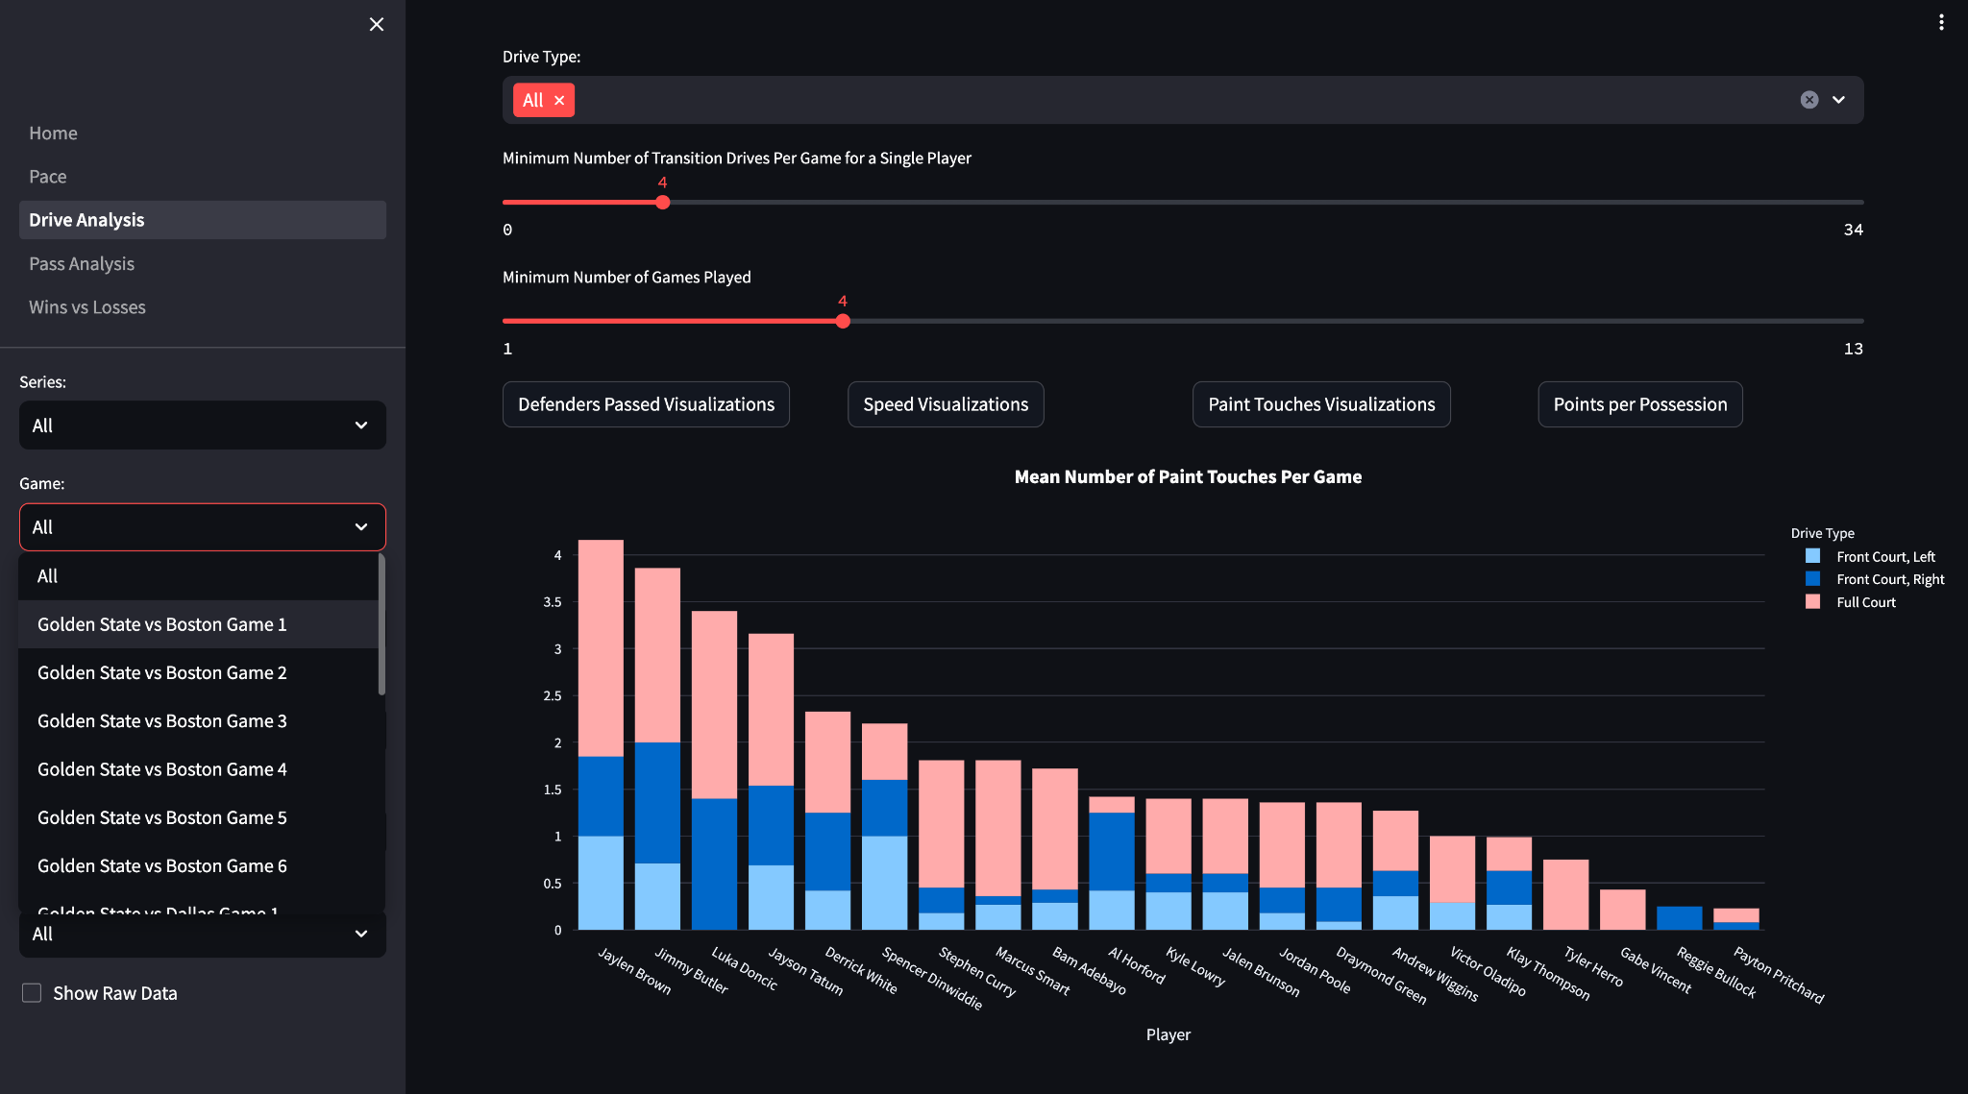
Notes:
So for example, selecting Game 1 of the Finals between Golden State and Boston,

Slide 37
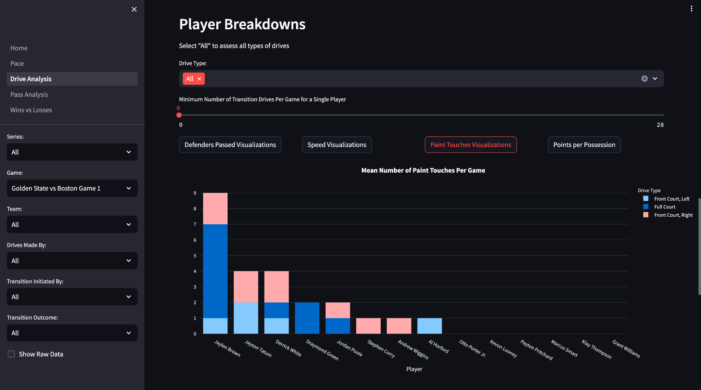
Notes:
Boston got to the paint a ton, and Jaylen Brown himself got into the paint 9 times, which is over twice his average shown on the previous slide - so Golden State did a really poor job of picking him up and containing him as well as Jayson Tatum and Derrick White.
Golden State lost this game and gave up 120 points, and compared to game 2, where Golden State won and only gave up 88 points,

Slide 38


Slide 39
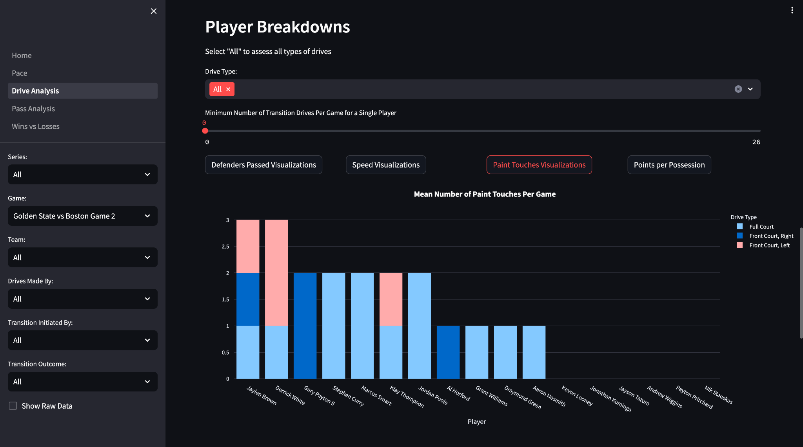
Notes:
you can see that Boston got war less transition paint touches which means they probably had to work harder for their shots.
Now this wouldn’t be the one reason why Golden State won or lost these games, but when margins of error for winning and losing can be so small, I think this could be helpful for finding and addressing some ways that you can tilt that margin in your favour.
Or even validating how a game felt. If it felt like were carved you up in transition, you have the numbers to prove it.

Slide 40
Future Work
Clean up data collection
Assess where teams are getting their shots
Include links to videos
Assess teams/players using a machine learning model
Notes:
So moving forward with this work, there are a lot of things I would like to do
First off I would like to clean up and get more indepth with some of the data collection, such as a better way to define a drive and a paint touch, and also collect where teams are taking their shots from
I would also like to add links to videos to be able to watch the plays behind the stats
And finally I would really like to take what I’ve learned from this and build on it to create a machine learning model to measure how well a team is capitalizing on their transition opportunities

Slide 41
Thank you!
Questions?
Notes:
Thank you for listening!
I’m happy to answer any questions!

